Slide 1


Delay-Phase Precoding for THz Massive MIMO with Beam Split
Jingbo Tan, Linglong Dai
Department of Electronic Engineering
Tsinghua University
2019.12.11
Notes:
Hello everyone, today I am very glad to introduce our work in Globecom. My name is Jingbo tan, comes from Department of Electronic Engineering, Tsinghua University. Today, the title of my speech is Delay-phase precoding for THz massive MIMO with beam split. In THz massive MIMO system, due to the large bandwidth and large antenna number, the frequency-independent beams will split to separated directions, which may induce serious array gian loss. To solve this problem, we propose the delay-phase precoding structure, where a delayers network is introduced between the RF chains and traditional phase-shifters. Analysis and simulations show that by utilizing the frequency-dependent phase-shifts, our proposed delay phase precoding can achieve near-optimal performance.

Slide 2
Background
Beam split
Delay-phase precoding
Simulation results
Conclusions
Notes:
My speech includes five parts: background, beam split, time-phase precoding, simulation results, and conclusions. At first, let me introduce the background.

Slide 3
Background
THz communication
  C ≈ B*M*log(1+SINR)：Expand bandwidth → Increase data rate
  Tens of GHz bandwidth in Terahertz communication
Millimeter-wave
Terahertz
0 Hz
6 GHz
30 GHz
100 GHz
300 GHz
10 THz
20 MHz
100 MHz
2 GHz
20 GHz
LTE
802.11ac
5G
EU 6G Project
Notes:
From shannon’s theory, we know that expanding bandwidth can increase data rate. This makes higher band becomes promising. For example, 5G network utilizes millimeter-wave with a bandwidth about 2 Gigahertz. For the future 6G network, to reach a further capacity improvement, terahertz band, which can provide tens of Gigahertz bandwidth, has drown a lot of attention. For an instance, the European Union has started their 6G project on THz frequencies with a bandwidth of 20 Gigahertz.

Slide 4

Background
THz massive MIMO
  Higher attenuation in THz frequency (160GHz: ~80dB/km）
  Massive MIMO: generate narrow beams, expand coverage
THz massive MIMO is the key technique in future 6G communciations
Notes:
While, the THz signal suffers from severe attenuation, which makes THz communication limited by small coverage. To solve this problem, massive MIMO can be utilized to expand coverage by generating directional narrow beams. Thus, THz massive MIMO may be one of the key techniques in future 6G communication.

Slide 5
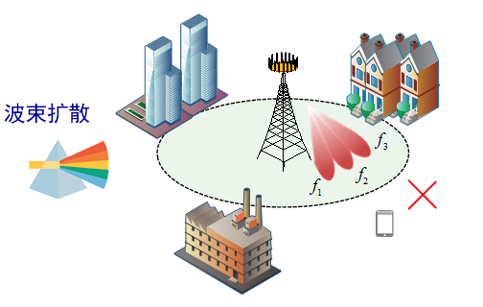
Background
Beam split in THz massive MIMO
  Phase-shifters (PSs) based hybrid precoding is frequency-independent
  The beams disperse to different directions at different frequency
  Totally separated beams due to large bandwidth and large antenna number
Beam Split
Beam split is a bottleneck problem in THz massive MIMO
Notes:
To reduce the huge power consumption, hybrid precoding which reduces the number of RF chains is considered to be exploited in THz massive MIMO. However, since the phase-shifters in analog beamformer is frequency-independent, the beams generated by these PSs will disperse to different direction at different frequencies. Due to the large bandwidth and large antenna number, in THz massive MIMO, these beams at different frequencies will be totally separated, which may cause serious performance loss since the user may not be covered at most frequencies. We call this effect as beam split effect, which is a bottleneck problem in THz massive MIMO.

Slide 6
Background
Beam split
Delay-phase precoding
Simulation results
Conclusions
Notes:
Then, I will introduce the beam split effect and the corresponding performance loss in detail.

Slide 7

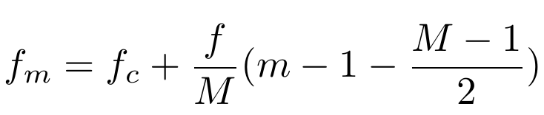
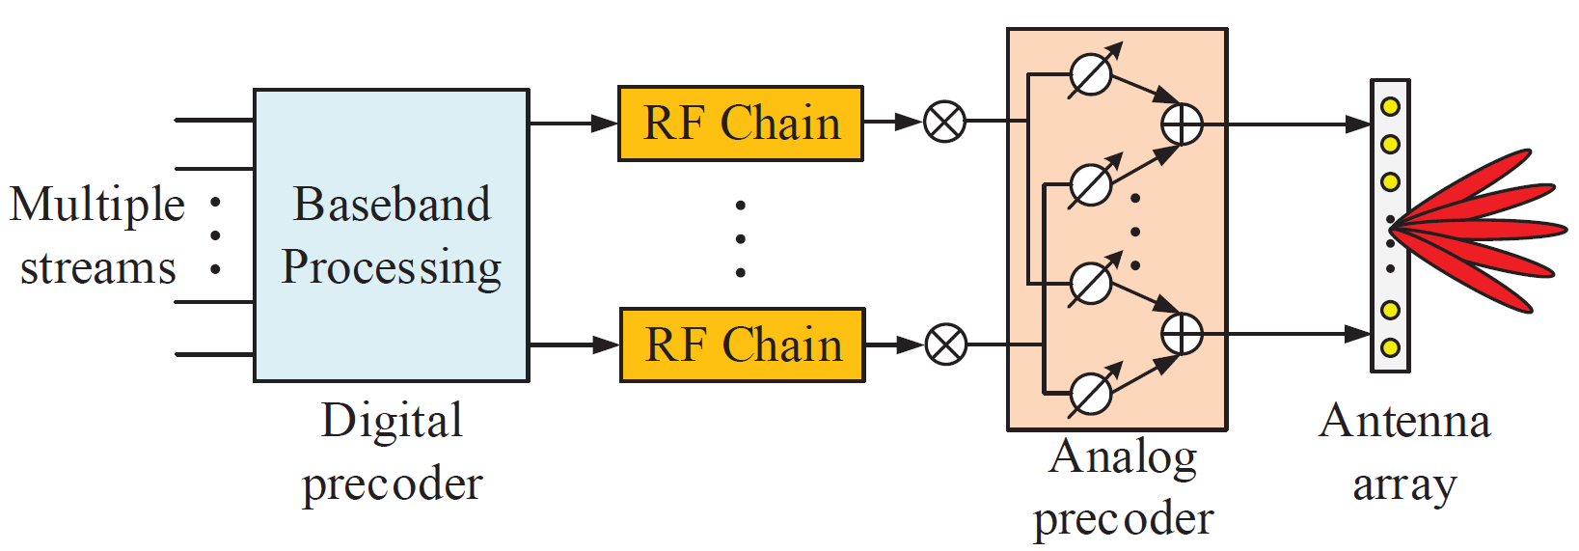
Beam split
System model
  Massive MIMO with OFDM, antenna BS and antenna user
  Analog beamformer , , digital precoder
  Carrier frequency , subcarriers, bandwidth
Notes:
Firstly, we introduce the system model. We consider a wideband THz massive MIMO systems. The BS equips N_{t} antenna serving a N_{r} antenna user. Then, considering the OFDM modulation and hybrid precoding structure at the BS, as shown in the picture, the received signals at the user at the m-th subcarrier y_{m} can be denoted as the equation, where matrix A is analog beamformer, which is usually realized by analog PSs, each of elements of A has constant amplitude and are frequency-independent, matrix D_{m} is the digital precoder at the m-th subcarrier, H_{m} is the channel at the m-th subcarrier. Denote the central frequency as f_{c}, the number of subcarriers is M and the system bandwidth is f, then the frequency of the m-th subcarrier can be denoted as the equation in the middle.

Slide 8
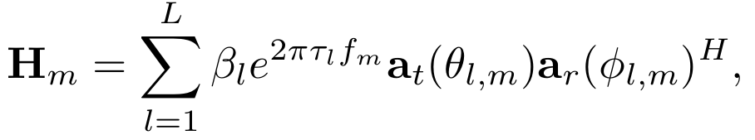
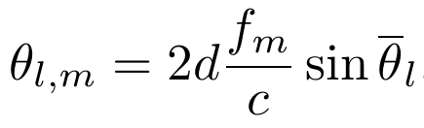
Beam split
System model
  Massive MIMO with OFDM, antenna BS and antenna user
  Analog beamformer , , digital precoder
  Carrier frequency , subcarriers, bandwidth
  Ray-based channel model
  Spatial direction
Notes:
For the channel, we utilize the widely used ray-based channel model, where H_{m} is a combination of multiple paths, vector a_{t} and a_{r} are steering vectors at the BS side and the user side. Specifically, for the m-th subcarrier, the spatial direction of the l-th path \theta_{l,m} can be denoted as this equation, where \bar{\theta_{l}} denotes the physical direction, d is the antenna spacing. Generally, the antenna spacing d is set based on central frequency as half wave length. For simplification, we utilize psi_{l} located between -1 and 1 to denote the physical direction in the remained slides.

Slide 9
Beam split
Angle-domain perspective
  Analog beamformer generate beams towards the channel physical directions
  Consider , generate a beam on at
  Array gain of on at frequency
  For on direction
  Where is relative frequency
Notes:
For traditional hybrid precoding, analog beamformer usually generates beams towards the channel physical directions to capture the spatial gain of massive MIMO channel. Without losing generality, we consider the l-th column of analog beamformer A, f_{l}, which is utilized to generate a beam towards psi_{l}. Then, f_{l} can de denoted as follow, which is equal to the steering vector on \psi_{l}. Denote the array gain of f_{l} on the physical direction psi_{l} at central frequency f_c as a function \eta. We can notice that the f_{l} can achieve the largest array gain 1 on \psi_{l} at the frequency f_{c}. However, for the m-th subcarrier, the optimal array gain cannot be achieved. Specifically, the array gain of f_{l} on physical direction \psi at f_{m} can be represented as follow, where \xi_{m} is the relative frequency. We can observe that the array gain may be affected by the subcarrier frequency. The following lemma will give a specific illustration.

Slide 10
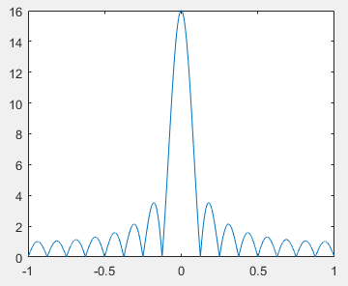
Beam split
Lemma 1. The optimal array gain of at disperses from to ,
And the array gain of on at is
Proof:
Dirichlet Sinc
Bandwidth
Antenna number
Notes:
Lemma 1, the optimal array gain of f_{l} at f_{m} disperses from \psi_{l} to \psi_{l,m}, where \psi_{l,m} equals \psi_{l} over \xi_{m} and the array gain of f_{l} on the targeted direction \psi_{l} at f_{m} can be denoted as this equation. The proof can be explained as follow: we can write the array gain as the form of dirichlet sinc function. Considering that dirichlet sinc get the maximum when x=0 as shown in the figure, we can obtain that f_{l} can achieve optimal array gain at \psi which makes , thus, we have 证明式. Then, let \psi=\psi_{l}, we have the array gain of f_{l} on \psi_{l} at the f_{m} as this function. From this function, we can notice that, the array gain of f_{l} at the targeted physical direction \psi_{l} is decided by antenna number and bandwidth. Firstly, with wider bandwidth, the beam f_{l} will disperse from \psi_{l} with a larger distance; Secondly, with larger N_{t}, the beamwidth or we say the mainlobe of the dirichlet function will be narrower. Therefore, in THz massive MIMO, with wide bandwidth and large antenna number, the beams at different frequencies will be totally separated with a very low array gain. We call this effect as beam split effect.

Slide 11
Beam split
Simulation results
  Parameters
  Totally separated beams, suffer serious array gain loss in THz case
  The wider the bandwidth, the serious the array gain loss
Notes:
Then, we provide a simulations to show the beam split effect. The figure on the left side shows the array gian towards different physical directions. We can observe that when f=5GHz, the beams at f_{1}, f_{c} and f_{m} are totally sepearated. This means that the user can not be efficiently covered at f_{1} and f_{M}. For the figure on the right side, the array gain on the targeted physical direction \psi_{l} at different subcarrier m is illustrated. We can observe that with bandwidth of 5GHz, about 50% subcarrier will suffer from nearly 80% array gain loss. This array gain loss is so serious that may cancelling the performance gain from utilizing wide bandwidth. Therefore, to compensate for the array gain loss caused by the beam split effect is essential in THz massive MIMO systems.

Slide 12
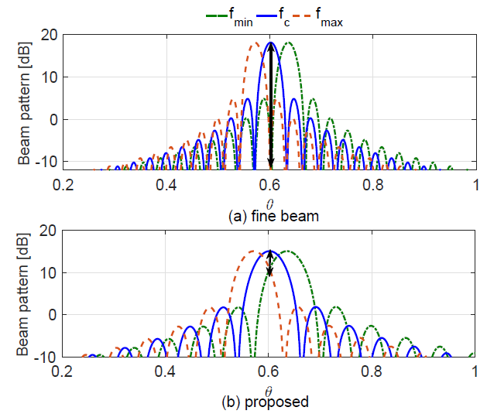
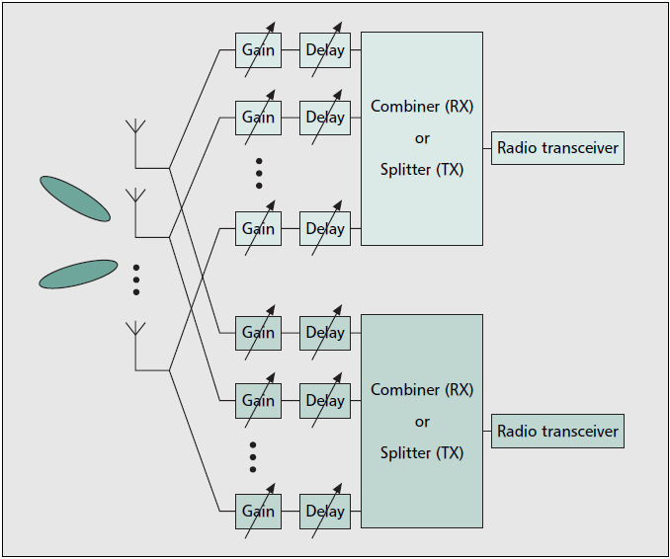
Beam split
Existing solutions
  Phase-shifters: generate wider beam
  True-time-delay: compensate the beam split in time-domain
Reduced the array gain loss
large complexity and power consumption
Notes:
There are several existing solutions. The first one is to design wider beam to cover the user at all the subcarriers. However, it still suffer from array gain loss to some degree. Secondly, the true-time-delayers can be utilized to replace the frequency-independent PSs. While, it will introduce large complexity and power consumption, which is not practical for THz massive MIMO systems.

Slide 13
Background
Beam split
Delay-phase precoding
Simulation results
Conclusions
Notes:
To solve the severe performance loss caused by the beam split effect, we propose the delay-phase precoding. Then, I will introduce this structure.

Slide 14

Delay-phase precoding
Delay-phase hybrid precoding
  Realize frequency-dependent phase shift by a two-stage structure
  Phase-shifters network: beamforming on physical direction
  Delayers network: compensate for the beam split
RF chain
RF chain
Delayers
Phase-shifters
Phase-shifters
Notes:
We can notice that the reason of beam split effect is that only frequency-independent phase shift can be realized by traditional hybrid precoding structure. Therefore, we propose the delay-phase precoding structure to realize frequency-dependent phase shift. Specifically, a delayers network is introduced between RF chain and PSs network. The figure shows the connection relationship for one RF chain, we can see that the RF chain is connected to a group of delayers and for each delayer, part of the PSs and antenna element is connected in a subconnected manner. Since a delay in time domain corresponds to different phase shifts in frequency domain, the frequency-dependent phase shifts introduced by the delayers can be utilized to compensate for the beam split effect.

Slide 15
Delay-phase precoding
Beamforming design
  Suppose delayers and
  becomes frequency-dependent, denote as
  denotes the phase shift realized by time delayers
Delayers
Phase-shifters
Notes:
Specifically, let us still consider the beamforming vector for the l-th physical direction. We suppose that for each RF chain, K delayers is connected, and P is defined as N_{t} over K. Considering that the beamforming vector f_{l} becomes frequency-dependent, we use f_{l,m} to denote it. f_{l,m} can be represented as this equation. This diagonal matrix is the frequency-independent phase shifts realized by PSs, and the vector p_{l,m} composes of frequency-dependent phase shifts realized by delayers. Specifically, p_{l,m} has the form as follow, where vector t denotes the time-delays of K delayers.

Slide 16
Delay-phase precoding
Lemma 2. When satisfies and has
has , then the physical direction of is
and the array gain on satisfies
Proof:
Notes:
Lemma 2 provides the instruction about how to compensate for the beam split effect by utilizing delayers. It says that when PSs generate beams towards \psi_{l}, and the phase shifts realized by delayers p_{l,m} has the form as this, the physical direction of f_{l,m} can be denoted as the following function, and the array gain on \psi_{l,m} is ( ). The proof of Lemma 2 is as follow, we can rewrite the array gain as a product of two dirichlet functions. As shown in this figure, the red line is Sigma_{K} and blue line is \Sigma_{p}. We can observe that the maximum point of \eta can aproximately obtained when () equals 0, then we have \psi_{l,m} (), and by substituting this into this function, we have the array gain on \psi_{l,m}. From lemma2, we can notice that the phase shifts in p_{l,m} can slightly change the direction of original beam from \psi_{l} over \xi_{m}.

Slide 17
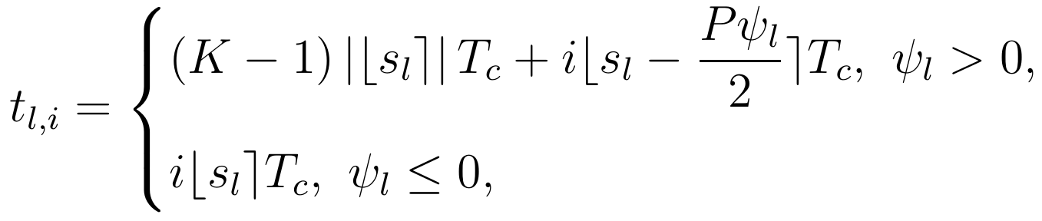
Delay-phase precoding
Beamforming design
  Based on Lemma 2, let can compensate for beam split
  Since , and should be unchanged
  denotes the number of periods, and period
PSs generate original beam
Delayers adjust direction
PSs
Delayers
Time delay is not
dependent on frequency
Notes:
Then, based on lemma 2, the beamforming design of time-phase precoding can be realized by two steps: firstly, the PSs generate original beam on \psi_{l}, and then, delays adjust the beam direction from the dispersed direction to \psi_{l}. By this way, the beams is expected to be aligned with \psi_{l} at all frequencies. Specifically, to calculate the time-delay that should be realized by delayers, let \psi_{l,m} equals to \psi_{l}, then we have \beta. Since p_{l,m} has the form as, and for the central frequency, the phase should be unchanged. The time-delays t_{l} should satisfy the form (), where s_{l} denotes the number of periods, and T_{c} is the period of central frequency. Finally, let the phase shift of delayers equals to \pi\beta and notice that the time delay should be positive and s_{l} should be an integer. We can obtain the delays t_{l,i} as this form. We can observe that t_{l,i} is not dependent on frequency. Thus, we can conclude that by setting t_{l,i} like this, the beam split effect can be mitigated.

Slide 18
Delay-phase precoding
Number of delayers and array gain
  We have ignored a restriction
  Considering that and
  Recall Lemma 2
Decided by antenna number
and relative bandwidth
Narrowband
Delay-phase precoding degenerates to traditional structure
Notes:
An important question of time-phase precoding is that how many delayers is sufficient. Actually, we have ignored that \beta_{l,m} has a range restriction as . Thus, to compensate for the beam split effect at all physical directions and all frequencies. We can obtain the lower bound of K, which is decided by antenna number and relative bandwidth. Recall Lemma 2, when K satisfies this restriction, array gain achieved by time-phase precoding is larger than 0.64. This is much better than the traditional structure. It should be emphasized that in narrowband case that f_{m} equals to f_{c}, K can be set as 0, which means the delay-phase precoding degenerates to traditional hybrid precoding structure.

Slide 19
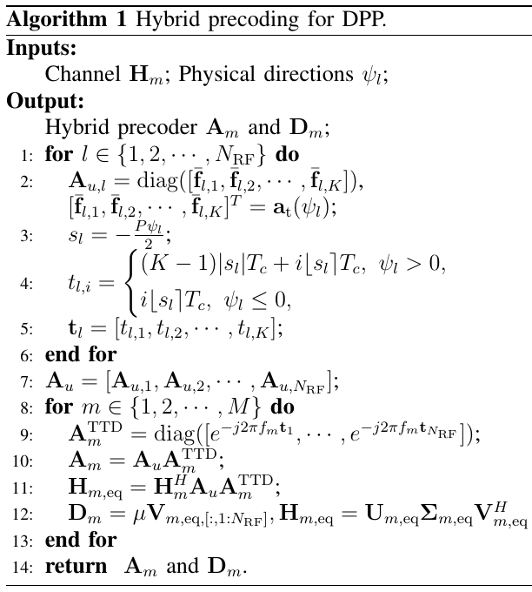
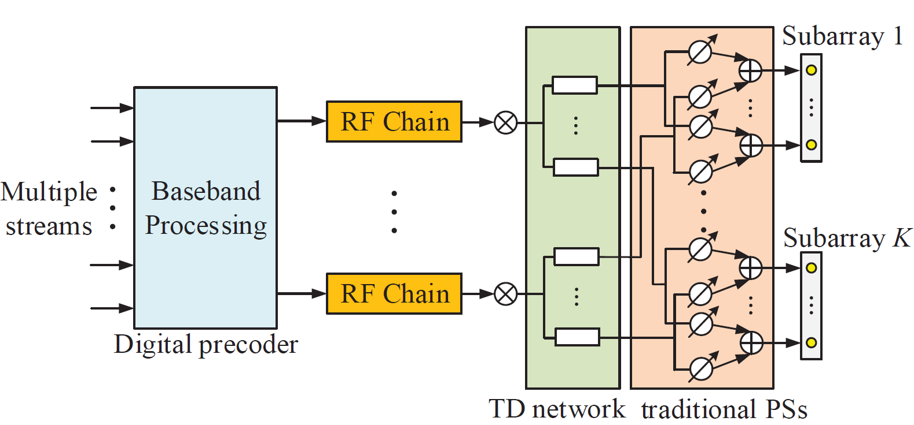
Delay-phase precoding
Hybrid precoding design
Channel and physical directions sorted by path gains
For each path, generate directional beams
For each subcarrier, carry out SVD digital precoding
Notes:
Finally, based on the beamforming design, we propose a hybrid precoding method for delay-phase precoding structure. Specifically, with known channel and physical directions sorted by path gains, we firstly generate directional beams for each path. Then, based on the analog beamformer, for each subcarrier, the SVD digital precoding is carried out.

Slide 20
Background
Beam split
Time-phase precoding
Simulation results
Conclusions
Notes:
Then, we will show the simulation results.

Slide 21
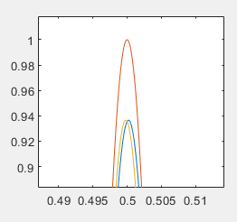
Simulation results
Array gain
  Parameters:
  Delayers network can compensate for the beam split
  Near-optimal array gain can be achieved over whole bandwidth
Notes:
Firstly, the array gain of the beams generated by the delay-phase precoding is shown. From the figure on the left side, we can notice that the beams at f_{1} and f_{M} is aligned with the desired direction \psi_{l}=0.5, this means that the delayers network can compensate for the beam split effect. For the figure on the right side, we can observe that the proposed delay-phase precoding, which is shown in the purple line, can obtain near-optimal array gain over whole bandwidth, which is much better than traditional structure.

Slide 22
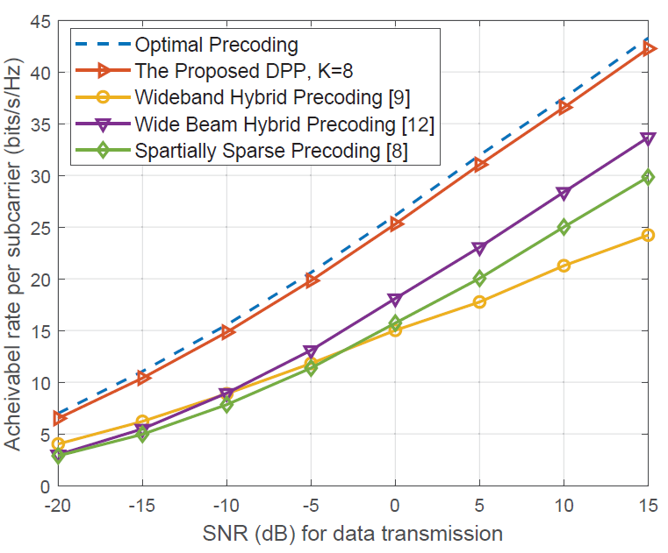
Simulation results
Achievable rate
  Parameters:
  Time-phase hybrid precoding can achieve near-optimal performance
Notes:
Then, we provide the achievable-rate performance. We can notice that, compared with traditional hybrid precoding methods such as wide beam based hybrid precoding, spatially sparse precoding, and optimization based hybrid precoding, our proposed delay-phase precoding, which is shown in red line, can achieve better and near-optimal performance.

Slide 23
Background
Beam split
Time-phase precoding
Simulation results
Conclusions
Notes:
Finally, we will give the conclusion

Slide 24
Conclusions
Beam split
  Beams generated by phase-shifters split in wideband THz case
  The wider the band and the larger the antenna number, the serious the loss
  Frequency-independent phase shift is the main reason
Delay-phase precoding
  Realize frequency-dependent phase shift by two-stage networks
  Phase-shifters network generates beams toward desired directions
  Delayers network compensate for the beam split effect
  Analysis and simulations shows delay-phase precoding can achieve near-optimal performance
Notes:
We first introduce the beam split effect in THz massive MIMO, the beams generated by PSs will split in wideband THz case due to large bandwidth and large antenna number. The main reason is frequency-independent phase shift. To solve the performance loss caused by the beam split effect, we propose a delay-phase precoding structure, which introduces a delayers network to realize frequency-dependent phase shift. Analysis and simulation results show that the proposed delay-phase precoding can achieve near-optimal performance.

Slide 25
Reference
X. Gao, L. Dai, S. Zhou, A. Sayeed, and L. Hanzo, “Beamspace channel estimation for wideband millimeter-wave MIMO with lens antenna array,” in Proc. IEEE Int. Conf. Commun. (IEEE ICC’18), Kansas, US, May 2018.
S. Park, A. Alkhateeb and R. W. Heath, "Dynamic Subarrays for Hybrid Precoding in Wideband mmWave MIMO Systems," in IEEE Transactions on Wireless Communications, vol. 16, no. 5, pp. 2907-2920, May 2017.
M. Cai et al., "Effect of Wideband Beam Squint on Codebook Design in Phased-Array Wireless Systems," 2016 IEEE Global Communications Conference (GLOBECOM), Washington, DC, 2016, pp. 1-6.
X. Liu and D. Qiao, "Space-Time Block Coding Based Beamforming for Beam Squint Compensation," to appear in IEEE Wireless Communications Letters.
B. Wang et al., "Spatial-Wideband Effect in Massive MIMO with Application in mmWave Systems," in IEEE Communications Magazine, vol. 56, no. 12, pp. 134-141, December 2018.
J. H. Brady and A. M. Sayeed, "Wideband communication with high-dimensional arrays: New results and transceiver architectures," 2015 IEEE International Conference on Communication Workshop (ICCW), London, 2015, pp. 1042-1047.
Notes:
Here are the references

Slide 26
Thank you！
Delay-Phase Precoding for THz
Massive MIMO with Beam Split
Jingbo tan, Linglong Dai
2019.12.11
E-mail: tanjb17@mails.tsinghua.edu.cn
Website: http://oa.ee.tsinghua.edu.cn/dailinglong/
Notes:
Thank you!

